Slide 1
TDT4258: Low-Level Programming
Caches
Virtual Memory
Rakesh Kumar
Computer Architecture Lab
Department of Computer Science
Some of the slides are based on other courses around the world: University of Edinburgh, NTNU, etc.

Slide 2
Cache organizations
Direct mapped
A block can be placed only by one location in the cache
Fully associative
A block can be placed anywhere in the cache
n-way set associative
A block can be placed at one of the predetermined n locations in the cache

Slide 3
Problem with Direct Mapped Caches
1-byte
Cache hit/miss
0000
0001
Address
0010
Miss
0000
Data
Valid
Tag
1-byte
1-byte
0011
Miss
0100
16-entries
0100
1
00
00
0
01
Miss
0000
0
0
0101
Miss
0100
1
0000
0101
Miss
Cache
Miss
0100
0111
1000
An access evicts the data brought in by the previous access
All accesses compete for the same cache location
All other locations are empty
…
1111
Memory

Slide 4
Fully Associative Caches
1-byte
0000
0001
Address
0010
Miss
0000
Data
Valid
Tag
1-byte
1-byte
0011
Miss
0100
16-entries
0100
1
00
Hit
0000
0
000
0101
0100
1
01
Hit
0
010
0101
Hit?
0010
0111
1000
Index bits in Direct Mapped cache become part of tag in Fully Associative cache.
…
1111
Memory
Q: What do we use it for?
A: Use it as part of the tag.

Slide 5
Fully-associative caches
requested address:
tag
byte offset
Cache
valid
tag
data block
Correct cache block identified by matching tags
Address tag can potentially match tag of any cache block
Byte offset selects word/byte within block

Slide 6
Set Associative Caches
Problems with other cache organizations:
In a direct-mapped cache, several addresses might compete for a few cache location while the other locations remain unused, thus lowering cache hit rate.
In a fully-associative cache, search for matching tags is either very slow, or requires a very expensive memory type called Content Addressable Memory (CAM)
Set associative cache offer a compromise between direct mapped and fully associative caches.

Slide 7
Set Associative Caches
Address
Address
00000
Data
00000
Data
Valid
Tag
1-byte
1-byte
Valid
Tag
1-byte
1-byte
00
Set
0
Set
01
10
Set
1
11
Direct Mapped Cache
2-way Set Associative Cache
Index bits pick n cache blocks (one set) for tag comparison, where n is called the number of ways in the cache.
Index bits pick one cache block for tag comparison.

Slide 8
Set Associative Caches
Address
Address
00000
Data
00000
Data
Valid
Tag
1-byte
1-byte
Valid
Tag
1-byte
1-byte
00
Set
0
Set
01
10
Set
1
11
Direct Mapped Cache
2-way Set Associative Cache
Data
Valid
Tag
1-byte
1-byte
Address
0
Set
00000
Set
1
Set
Fully Associative Cache

Slide 9
More cache terminology
Block (or line): the unit of data stored in the cache
Typically in the ranges of 32-128 bytes
Set: A group of blocks
Way: A block in a set
Number of ways defines number of blocks in a set
E.g. a 4-way set associative cache has 4 blocks in each set
2 to 32 ways are common
Fully associative cache: #ways = #blocks
Caveat: “Index” bits in address do not select a cache block, rather a cache set.

Slide 10
Cache replacement
What to do when we run out of cache space
Need to evict a block to make space for the new one
Which block to evict?
The block which is not going to be used soon
Replacement policies
Random
LRU (Least Recently Used)
FIFO (First In First Out)
….

Slide 11
Cache replacement
Least Recently Used (LRU)
Evict the cache block that hasn’t been accessed longest
Relies on past behaviour as a predictor of the future
Complex implementation
FIFO – replace in same order as filled
Simpler to implement
Example:
address references: 0 2 6 0 7 8
Cache with 4 blocks
LRU
FIFO
8
0
0
0
0
8
2
2
6
6
7
7

Slide 12
Writing to caches
When to write the modified data to memory?
Write-back: When the block is evicted
Write-through: While writing to cache
Write-back:
Pro: Consolidate multiple writes to the same block
Saves bandwidth and energy
Con: Need to track dirty (modified) blocks
Write-through:
Pro: Simpler implementation and coherence.
Con: Slow, bandwidth intensive

Slide 13
Write-through
Always write to memory
Write is as slow as write to memory (not cache)
store 24 → 0x8
Tag
Data
Data
V
100
00
0
16
1
24
0
CPU
0
0
0
0x00 000000 32
0x04 000100 20
0x08 001000 16
0x0c 001100 00
0x10 010000 03
0x14 010100 00
…
24
13

Slide 14
Dirty bit keeps track of whether the cache block has been written.
If it is dirty, we need to write it back to DRAM when we evict it.
Write-back
Write only to cache
Write happens at the speed of cache
store 24 → 0x8
Tag
Data
Data
V
D
100
00
0
1
16
1
24
0
0
Note: the cache and memory are now not the same!
When we evict a line we need to know if it is different from the DRAM to write it back
CPU
0
0
0
0
0
0
0x00 000000 32
0x04 000100 20
0x08 001000 16
0x0c 001100 00
0x10 010000 03
…

Slide 15
Cache performance
AMAT = (hit rate * hit-time) + (miss rate * miss-latency)
Hit time = 1
Miss latency = 4
Hit
Miss
Mem
Mem
Mem
Mem
Mem
Mem
Hit
Miss
Hit
Hit
Miss
Hit
Miss rate = 2/6 = 33%; hit rate = 4/6 = 66%
AMAT = (0.66)*1 + (0.33)*(4) = 2.0 cycles per access

Slide 16
Cache hierarchy
Multiple level caches to balance capacity and access latency
Typically caches at all levels are made of SRAM
Cache closest to processor is small but fast
Caches further away from processor are increasingly bigger but slower
As size of SRAM grows, its access latency also increases
Last level cache
(LLC)
CPU
L2 cache
L1 cache
1-4 cycles
~10 cycles
30-60 cycles

Slide 17
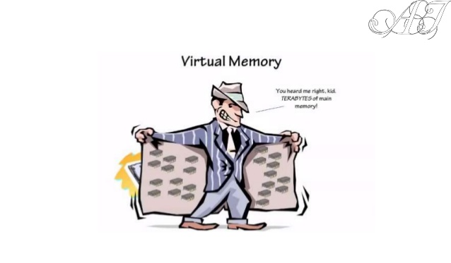
Virtual memory

Slide 18
Motivation
Virtual memory addresses two main issues
Capacity: how to relieve programmers from dealing with limited main memory capacity?
To allow physical memory to be smaller than the program’s address space (e.g. 32bit → 4GB)
To allow multiple programs to share limited physical memory
Safety: how to enable safe and efficient sharing of memory among multiple programs
To prevent user programs to access memory used by OS
To control the access by one user program to the memory of other user programs

Slide 19
Virtual memory
Idea: make each program think that it owns the entire memory.
Virtual address space: addresses visible to the programmer
E.g. PC, load/store addresses
Physical address space: actual main memory addresses
Addresses used to access cache/ memory
Address translation
Virtual address are translated on-the-fly to physical addresses
The translation is done jointly by hardware and OS
Parts of virtual address space not used recently is store on disk, not in memory

Slide 20
Address Translation
Two styles of address translation
Paging: Basic translation units are fixed size memory regions, called pages.
Segmentation: Basic translation units are variable size memory regions, called segments.
We will focus on paging as it is used more commonly

Slide 21
Paging
A cache line or block of virtual memory is called a page
“page” or “virtual page” for virtual memory
“page frame” or “physical page” for physical memory
Typical page sizes are 4-8 KB (MB or GB in servers)
Large enough for efficient disk use and to keep translation tables (aka page tables) small
Translation is done through per program page tables
Different programs can use same virtual address

Slide 22
Virtual to physical mapping for 1 program
Virtual Address Space (4 GB)
Physical Memory (1 GB)
0
A
B
C
D
0
A
C
B
₂12
Hardware/OS
2³⁰-1
OS Virtual Memory Manager
Cache for disk
2³²-1
D
Disk

Slide 23
Page address translation
Page offsets not translated
Page number is translated via page table
Example: 1KB pages
virtual address: 32 bits V O
page table base address (physical)
page number
(22 bits ⇒ 4M pages)
page offset (10 bits ⇒ 1KB)
+
frame number
 |  |  |  |  |  | F
status bits
Page table entry (PTE)
F O
physical address: 30 bits (1GB of main memory)
Page table is stored in main memory

Slide 24
Practice problem
What is the size of the page table given a 32-bit virtual address space, 4 KB physical pages, and 1 GB of main memory?
Page offset: 12-bits
Virtual page number: 32-12 = 20-bits → 1M page table entries
Status bits: 6-bits
Physical page number: 30-12 = 18-bits
Page table entry size: 18+6 = 24-bits
Page table size: 24Mbits = 3MB
Do all applications use all of these entries?

Slide 25
Problem with one level page tables
Page table size:
3MB
Each application requires its own page table
100 concurrently executing applications would require 300MB for page tables
1/3 of physical memory (300MB of 1GB) is used up for page tables only
Waste of space if an application uses only a fraction of its virtual address space
One level page table reserves space for all possible virtual pages

Slide 26
Multi-level page tables
The last level tables hold the physical page number
A table at any other level holds pointer to tables at the next level.
Advantage: tables are inserted only if the corresponding part of the address space is in use
Physical
page

Slide 27
Storage cost for two level page table
virtual address: 32 bits V O
Storage per table:
3KB (1K entries, 3B/entry)
Covering full address space
1025 table (1 at 1st level, 1024 at 2nd level)
Storage: 3.003MB (1025*3KB)
Slightly higher than single level page table
Covering smaller address space
0x00000000 to 0x003FFFFF (4MB)
Needs only 2 tables (1 at each level)
Storage: 6KB
0x00000000 to 0x7FFFFFFF (2GB)
Needs 513 tables (512 at 2nd level)
Storage: 513*3KB = 1.503MB
10 bit
10 bit
12 bit
1024-entries
1024-entries
1024-entries
Page table storage varies with virtual address space actually used.

Slide 28
Address translation with 2-level page table
page table base address (physical)
virtual address: 32 bits V O
10 bit
10 bit
12 bit
+
+
F O
physical address: 30 bits (1GB of main memory)

Slide 29
Fast page table access
Problem: page table access adds to memory access latency
Two memory accesses per load/store (for single level page table)
one to get page table entry, one for actual load/store
Page table is in main memory, though data may be in cache
Solution: Translation Lookaside Buffer (TLB)
TLB is cache (typically fully associative) for page table
Small fast table located close to processor
Captures most translations due to principle of locality
TLB miss: translation not in TLB. Access page table and save the translation in TLB

Slide 30
TLB
TLB status bits
V (valid) bit
D (dirty) bit indicates whether page has been modified
R, W, X permission bits. Checked on every memory access
31 12 11 0
Virtual
Virtual Page Number
PageOffset
Address
V D R W X
Tag
Physical Page Number (PPN)
=
=
=
=
=
TLB hit
Physical Address
31 12 11 0
Physical Page Number
PageOffset

Slide 31
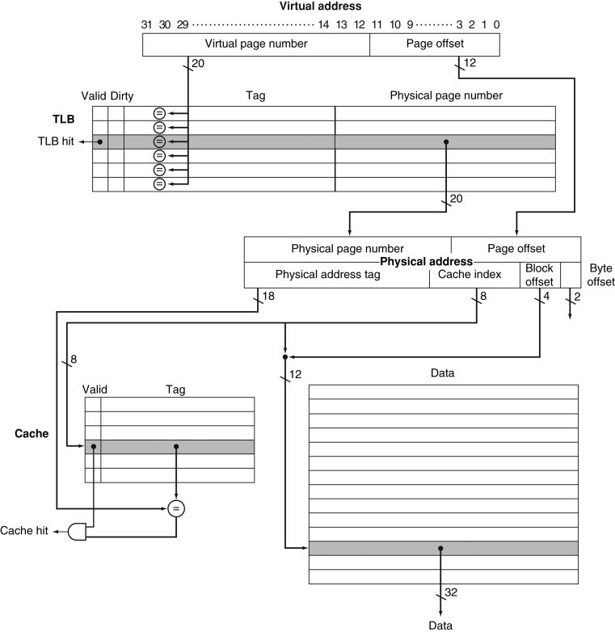
Integrating TLB with cache

Slide 32
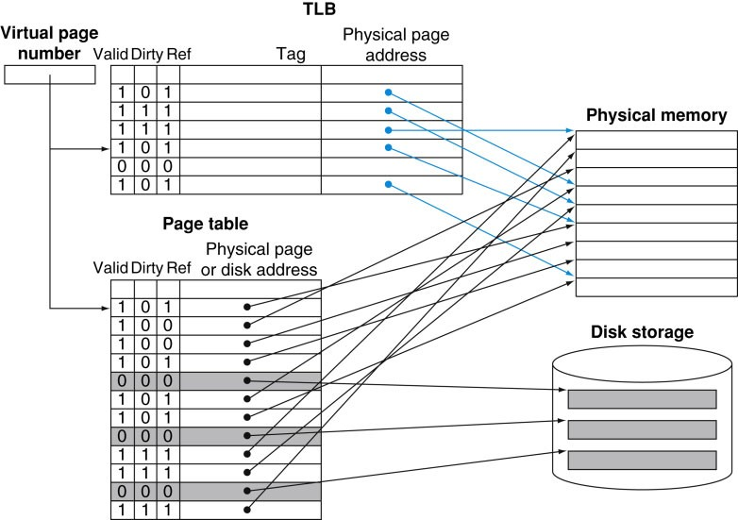
Virtual memory: full picture

Slide 33
Advertisement
Want to learn more
Computer Organization and Design, Patterson & Hennessy
Advanced courses
TDT4255-Computer Design and TDT4260-Computer Architecture
For projects and thesis opportunities, check out
Computer Architecture Laboratory
https://www.ntnu.edu/idi/lab/cal

